Slide 1
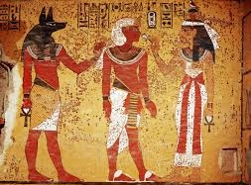
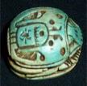

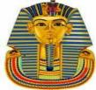

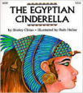



Ancient Egypt Year 5 Knowledge Mat
Subject Specific Vocabulary |  |  | Egyptian Artefacts
archaeologist | People who discover our history by looking at artefacts that have been found.
pharaohs | The word pharaoh originally meant ‘great house’, but came to mean the person who resided in it.
tombs | Ancient Egypt is known for its magnificent and beautiful tombs. The most well known are within the pyramids in the Valley of the Kings.
pyramid | A geometrical term that refers to part of the burial complexes for Egyptian pharaohs.
hieroglyphs | The term hieroglyph refers to the fact that it is carving for sacred things, but hieroglyphs were also written on papyrus.
 |  | Sticky Egyptian knowledge (3100 B.C. to 332 B.C)
River Nile | The Nile is a major north-flowing river in north-eastern Africa, and is the longest river in Africa .
Slavery | People that worked for their owners.
 |  | Cleopatra was the last pharaoh of Egypt before the Romans took over.
Culture | A pattern of behaviour shared by a society or a group of people. |  | Exciting books
 |  | Tutankhamun was known as the boy king, famous because his tomb was found in 1922.
sarcophagus | Sarcophagus is a Greek word meaning flesh-eating and refers to the mummy case.
 |  | Egyptian men and women wore make-up.
mummy | Remains of a body found inside the carved and brilliantly painted burial case known as a sarcophagus.
 |  | The Egyptians were the first civilization to invent writing.
Inventions | New things that are created or made.
Settlements | A small community of people.
scarab
sphinx
death mask

