Slide 1
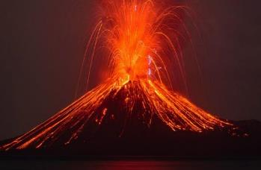
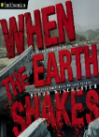
Movers and Shakers Knowledge Mat Y3 Summer Term
Subject Specific Vocabulary |  |  | Exciting Books
eruption | An explosion of steam or lava from a volcano.
aftershock | A shaking event that follows an earthquake. Sometimes more damaging than the original earthquake.
tsunami | A long, high wave usually caused by an earthquake in the ocean.
magma | Hot fluid or semi-fluid material below or within the Earth’s crust from which lava is formed.
lava | Hot, molten or semi-fluid rock erupted from a volcano, or solid rock, resulting from cooling of this. | Important Facts to know by the end of the topic.
dormant | A dormant volcano is an active volcano that has not erupted in the past 10,000 years. | Volcanoes are caused when magma rises to the surface of the Earth, which causes bubbles of gas to appear in it. This gas can cause pressure to build up beneath the surface, and it eventually explodes.
fault line | A fracture in the Earth's crust. Rocks on either side of the fault line slide past each other. |  | More Important Facts.
magnitude | If you talk about the magnitude of something, you are talking about its great size. | Earthquakes are usually caused when rock underground suddenly breaks along a fault. This sudden release of energy causes the seismic waves that make the ground shake. | The magnitude of an Earhquake is measured using a special scale called the Richter scale.
richter scale | The scale of numbers used to tell the power, or magnitude, of earthquakes.
tectonic plates | The Earth’s outer shell is made up of huge slabs of moving rock called tectonic plates. | A tsunami is a series of large waves generated by an abrupt movement on the ocean floor that can result from an earthquake, an underwater landslide, a volcanic eruption or - very rarely - a large meteorite strike. | The Ring of Fire is an area where there are many active volcanoes.
ash cloud | Ash clouds exist where a violent explosive eruption ejects volcanic ash into the atmosphere.

