Slide 1
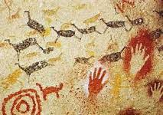
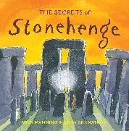
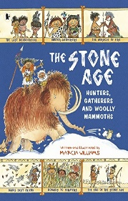
Early Britons Knowledge Organiser – Y3 Autumn Term
Subject Specific Vocabulary |  |  | Exciting Books
palaeolithic | Period known as the early part of the stone age.
mesolithic | Period known as the middle era of the stone age.
Neolithic | The later part of the Stone Age.
B.C. | Before Christ. The date 250BC means 250 years before Christ was born.
chronology | The ordering of events, for example: palaeolithic, mesolithic, neolithic. | Sticky Knowledge about the Stone-age period
extinct | A species of any living thing that no longer exists.
 |  | The Stone Age period is said to have started around 3 million years ago when humans started to live in Europe.
hunter-gatherers | People who mainly live by hunting wild animals and gathering wild fruit.
 |  | The Stone Age was followed by the Bronze Age period when humans started to use metal. | Art: We will create our own cave paintings using different types of brushes for specific purposes and explore the effect on paint by adding water, glue, sand and sawdust.
shelter | A place that provides protection from danger and bad weather.
 |  | The Bronze Age was followed by the Iron Age when tools and weapons became more advanced and were used for farming, hunting and fighting.
Stonehenge | Stonehenge is a prehistoric monument in Wiltshire, England, two miles west of Amesbury. It consists of a ring of standing stones, with each standing stone around 13 feet high, seven feet wide and weighing around 25 tons
settlement | A place with several shelters, like a small village.. | During the Palaeolithic Age (old Stone Age), people gathered food by hunting wild animals and birds, fishing, and collecting fruits and nuts.
 |  |  | Trip: We will visit the ECO centre in Southport to learn how our local environment was used during the stone age.
cave paintings | Cave paintings are a type of art, found on the wall or ceilings of caves created during the stone age period. | During the Neolithic Age (towards end of the Stone Age), the humans formed settled communities, and domesticated animals for the first time and began growing crops. The stone age people began farming.

